Slide 1
Rebuilding Together Northern Nevada
Repairing Homes | Revitalizing Communities | Rebuilding Lives
Safe Homes and Communities for Everyone!

Slide 2
Rebuilding Together (National)
Who We Are | Output (1988-2018) | Impact
Leading national nonprofit dedicated to repairing homes, revitalizing communities and rebuilding lives with a vision for safe homes and communities for every person 130+ affiliates that provide critical repairs to our neighbors’ homes and revitalize the communities where we live In 39 states plus the District of Columbia | 6.2 million people served 4.1 million volunteers mobilized 500,000 people living in safer homes 210,000 homes and nonprofit facilities repaired and rehabilitated | 90% plan to age in place 78% of service recipients stated that the home repair “helped a great deal” More than 25% of homeowners served felt an increased connection within their communities 11% reported that repairs kept them from being homeless “Since the repair, I enjoy life more and make the most of everyday…”

Slide 3
Who We Serve
Our low- and moderate-income neighbors in need
Older adults
Veterans
People with disabilities
Families with children
Victims of natural disasters

Slide 4
Eligibility
Applicant must own their home, live in it as their primary residence and intend to remain in the home for at least two years following completion of the work.
Mortgage, homeowner’s insurance and property taxes must be current.
Total gross combined income for all residents (18+ years) in cannot exceed following amounts. (max 80% AMI)
1 person - $42,000 | 2 persons – $48,000 | 3 persons - $54,000
4 persons - $60,000 | 5 persons - $64,800 | 6 persons - $69,600
7 persons - $74,400 | 8+ persons - $79,200

Slide 5
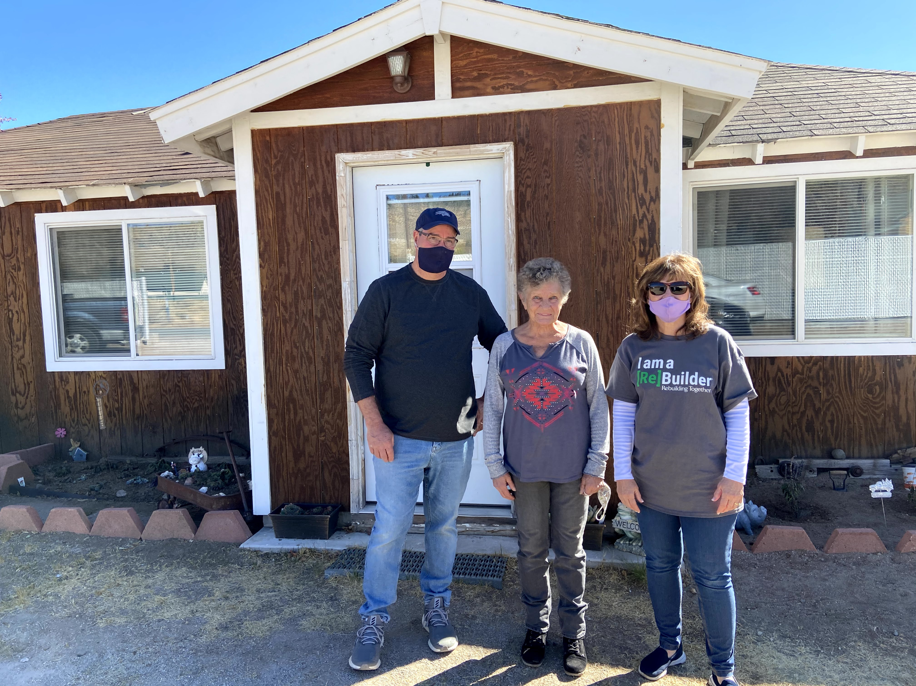
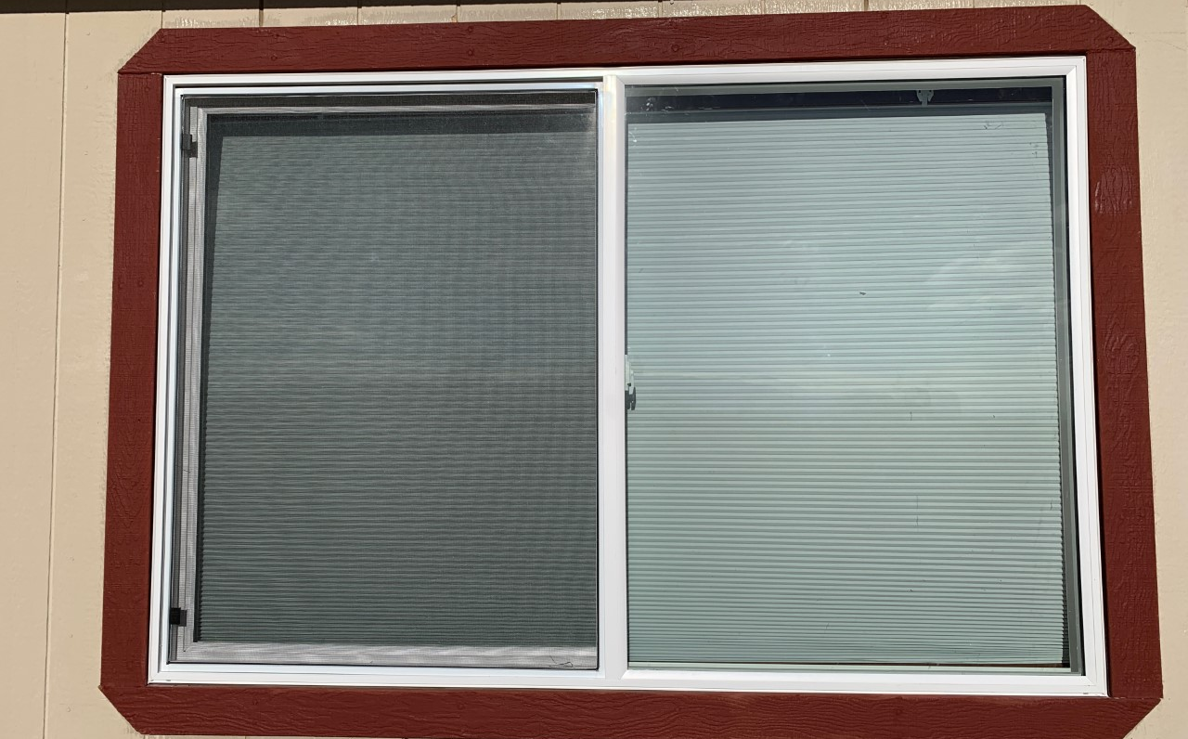
What We Do
Repair homes
Eight Principles of Healthy Homes
25 critical health and safety priorities
Revitalize and strengthen communities
Preserve affordable homeownership
Rebuild lives
Safe and healthy housing is the foundation, framework and focus of what we do.
We do this at no cost to the homeowner.

Slide 7
For More Information
rebuilder@rtnnv.org
Websites:
Local:
www.rebuildingtogethernnv.org or www.rtnnv.org
National
www.rebuildingtogether.org
Phone:
775.395.9808
Contacts:
Katie Pace, katiepace@rtnnv.org
Dan Dykes, dpdykes@gmail.com

Slide 8
Questions?

